Slide 1
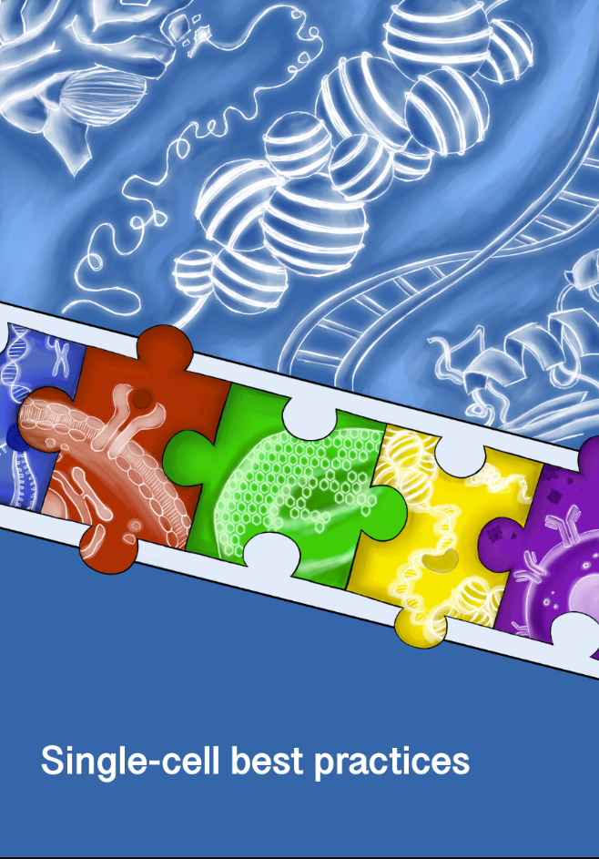
课程大纲
参考书籍和网络资源
第一周：基因转录调控的基本概念原理和多组学技术
第一节：基因转录调控的基本概念原理
第二节：基因转录调控的多组学技术原理
第三节：转录组学数据分析原理和软件介绍
课后作业：本地安装R并学习R的基本操作
第二周：基因转录调控的数据分析原理和应用软件
第一节：表观组学数据分析原理和软件介绍
第二、三节：单细胞数据分析原理和软件介绍
课后作业：本地安装R包(Deseq2/Seurat)
第三周：基因转录调控的分析案例和公共数据库资源
第一节：转录组学分析案例和公共数据库资源
第二节：表观组学分析案例和公共数据库资源
第三节：单细胞多组学分析案例和公共数据库资源
课后作业：本地实践R包demo流程
基因转录调控的实践操作和课程作业
案例一：RNASeq分析
案例二：单细胞RNASeq分析
RNASeq
[PDF] Introduction to differential gene expression analysis using RNA-seq
Deseq2
https://www.bioconductor.org/packages/release/bioc/vignettes/DESeq2/inst/doc/DESeq2.html
EdgeR
https://bioconductor.org/packages/release/bioc/html/edgeR.html
Single Cell RNASeq
Single-cell best practices
https://www.sc-best-practices.org/preamble.html
Scanpy – Single-Cell Analysis in Python
https://scanpy.readthedocs.io/en/stable/
Seurat
https://satijalab.org/seurat/
ChIP-Seq/ATAC-Seq
MACS: Model-based Analysis for ChIP-Seq
https://macs3-project.github.io/MACS/

Slide 2


基因转录调控的数据分析原理和应用软件
复旦大学 生命科学学院 生物信息学课程
董欣然
复旦大学附属儿科医院 分子医学中心
2024-11-14

Slide 3
第一节：表观组学数据分析原理和软件介绍

Slide 4
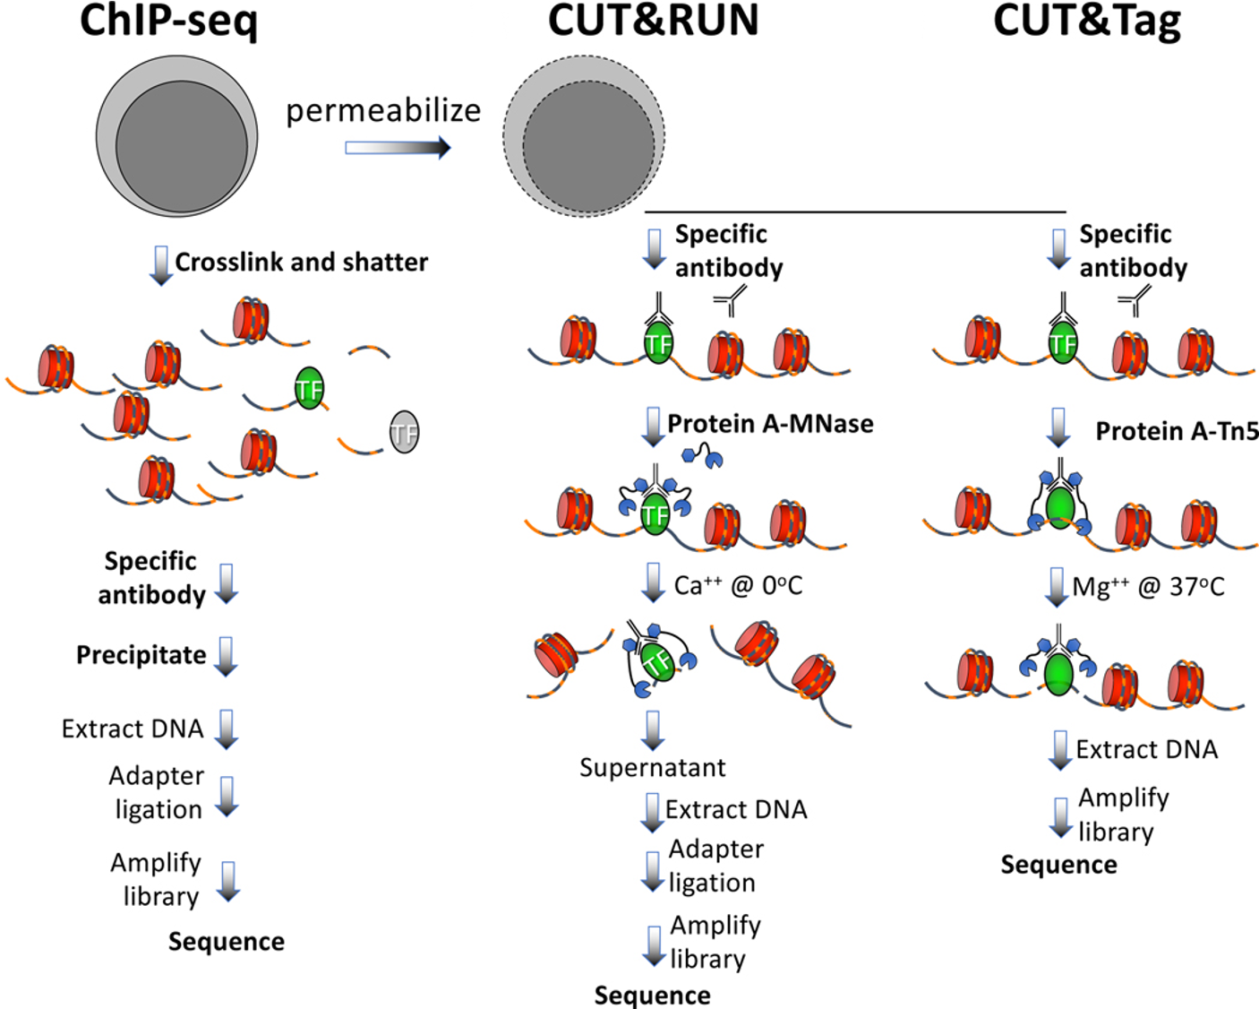
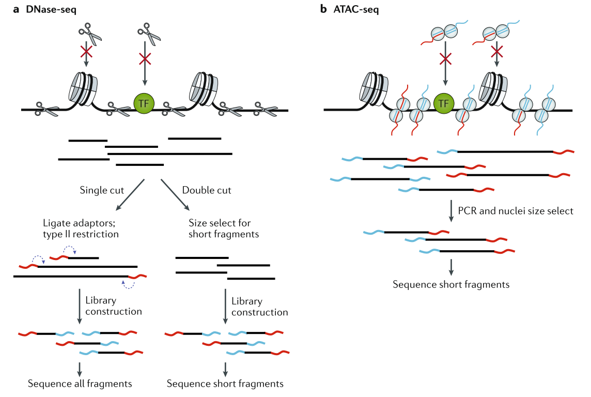
表观组学技术复习
转录因子结合位点
染色质可及性
Dnase I 酶切割未受保护的DNA
(开放染色质区域)
使用转座酶（Tn5）直接插入接头到开放的染色质区域 (开放染色质+TF/核小体占据区域)
增强细胞膜通透性
Kaya-Okur, H.S., Janssens, D.H., Henikoff, J.G. et al. Efficient low-cost chromatin profiling with CUT&Tag. Nat Protoc 15, 3264–3283 (2020). https://doi.org/10.1038/s41596-020-0373-x
Klemm, Sandy L., Zohar Shipony, and William J. Greenleaf. "Chromatin accessibility and the regulatory epigenome." Nature Reviews Genetics 20.4 (2019): 207-220.

Slide 5
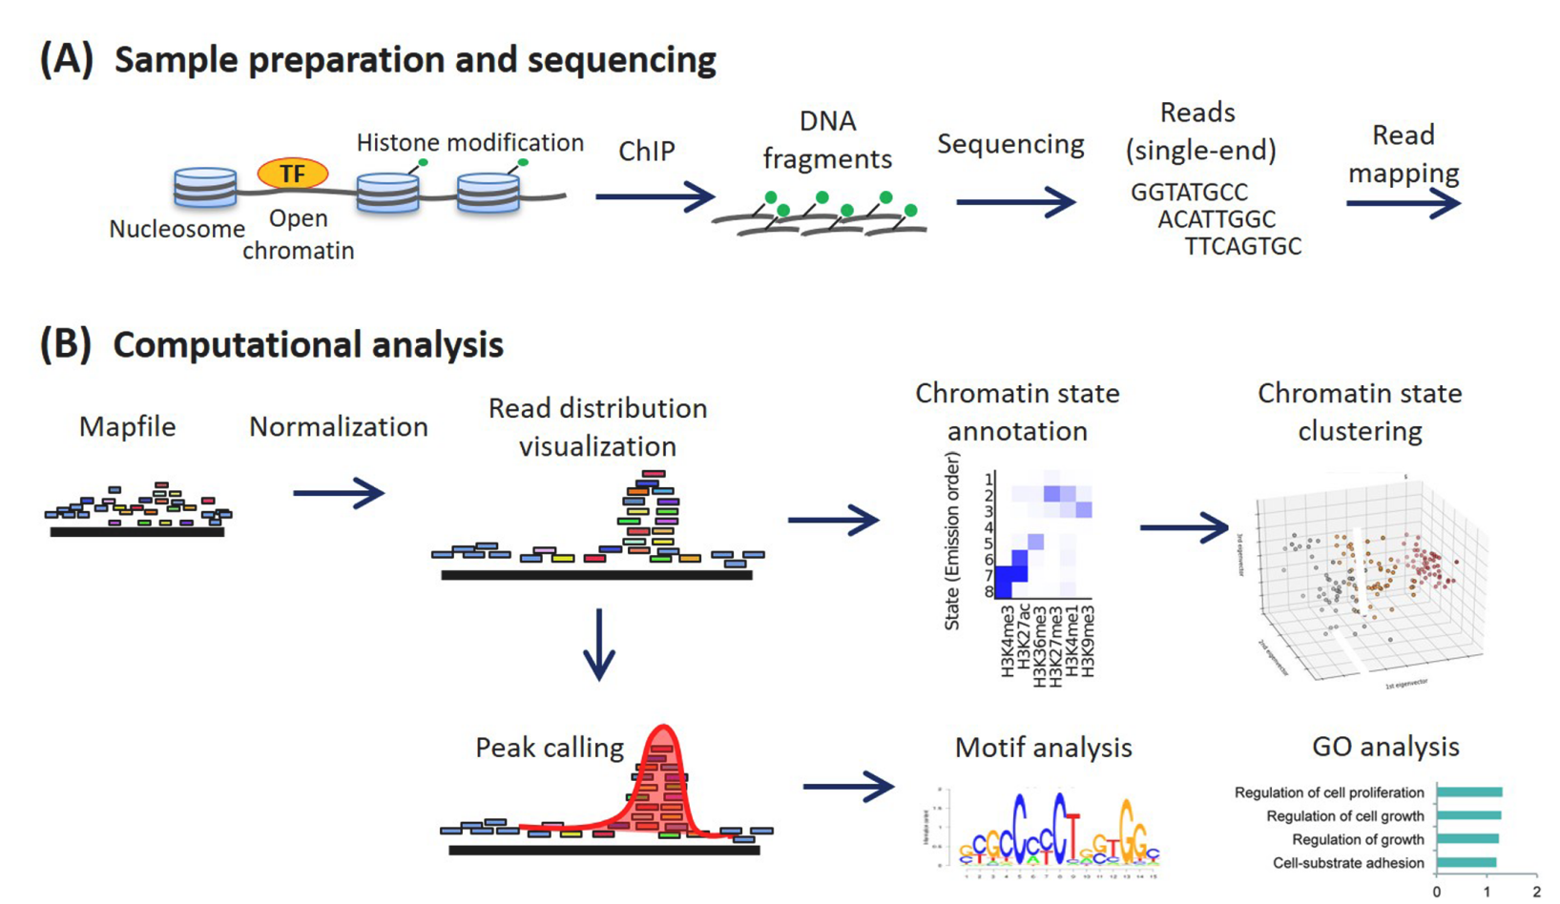
表观组学数据分析流程 (ChIP-seq)
Mapping
Peak Calling
Motif analysis
Visualization
Nakato, Ryuichiro, and Toyonori Sakata. "Methods for ChIP-seq analysis: A practical workflow and advanced applications." Methods 187 (2021): 44-53.
5

Slide 6
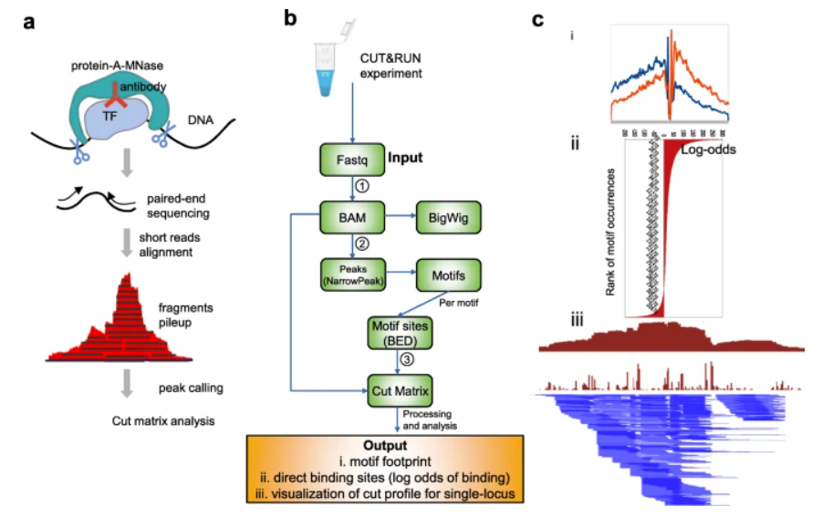
表观组学数据分析流程 (CUT&RUN/CUT&Tag)
Mapping
Peak Calling
Motif analysis
Visualization
Zhu, Q., Liu, N., Orkin, S.H. et al. CUT&RUNTools: a flexible pipeline for CUT&RUN processing and footprint analysis. Genome Biol 20, 192 (2019). https://doi.org/10.1186/s13059-019-1802-4
6

Slide 7
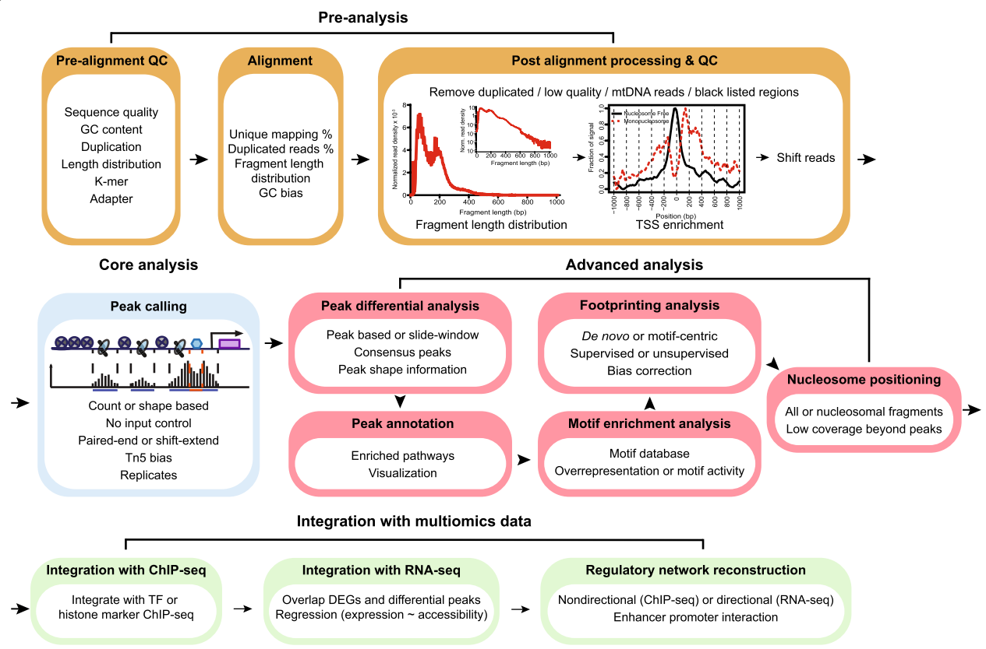
表观组学数据分析流程 (ATAC-seq)
Mapping
Peak Calling
Motif analysis
Visualization
Yan, F., Powell, D.R., Curtis, D.J. et al. From reads to insight: a hitchhiker’s guide to ATAC-seq data analysis. Genome Biol 21, 22 (2020). https://doi.org/10.1186/s13059-020-1929-3

Slide 8
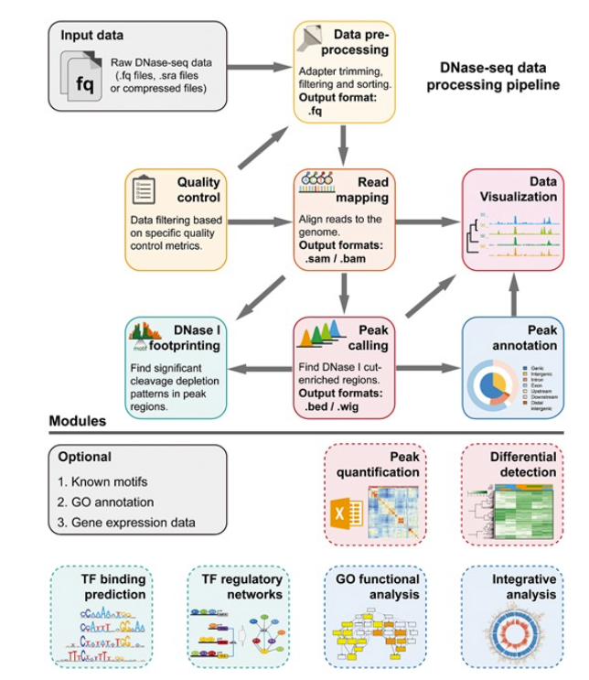
表观组学数据分析流程 (DNase-seq)
Mapping
Peak Calling
Motif analysis
Visualization
Yongjing Liu, Liangyu Fu, Kerstin Kaufmann, Dijun Chen, Ming Chen, A practical guide for DNase-seq data analysis: from data management to common applications, Briefings in Bioinformatics, Volume 20, Issue 5, September 2019, Pages 1865–1877, https://doi.org/10.1093/bib/bby057

Slide 9
表观组学数据分析简单流程介绍
Mapping
Peak Calling
Motif analysis
Visualization
数据流
数据格式
下机数据
FASTQ
GENCODE
(人和小鼠)
参考序列
FASTA
Mapping: STAR/Bowtie2
基因注释
GTF/GFF
比对数据
SAM/BAM
Format conversion: Samtools
Format conversion:
Bedtools/wigToBigWig
BEDGRAPH/WIG/ BIGWIG
分布分析
Peak calling: MACS / HOMER
峰值分析
BED/BIGBED
Motif
(JASPAR/TRANSFAC…)
GeneSet
(MSigDB/KEGG/GO/…)
下游分析 (功能富集分析图/热图/结合位点PWM图…)
Peak analysis: ChIPpeakAnno
Functional analysis: BETA
Motif analysis: MEME
Visualization: IGV / UCSC / …

Slide 10
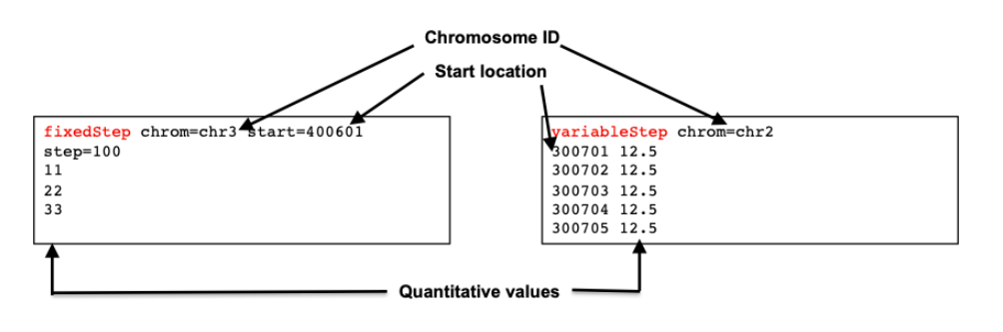
表观组学数据分析中的数据格式1
.wig (Wiggle)/ .bw (BIGWIG)
Bigwiggle：Wiggle的二进制文件
Wiggle：用来显示大小相同的密集连续分布数据 → 描述染色体上ChIP的连续信号值
两种声明的格式
variableStep – 数据点间隔不规律
chrom (染色体) + span (数据覆盖长度,optional)
fixedStep – 数据点间隔规律
chrom / start / step (数据间隔长度) / span -- optional
https://hbctraining.github.io/Intro-to-ChIPseq-flipped/lessons/08_creating_bigwig_files.html
https://useast.ensembl.org/info/website/upload/wig.html

Slide 11
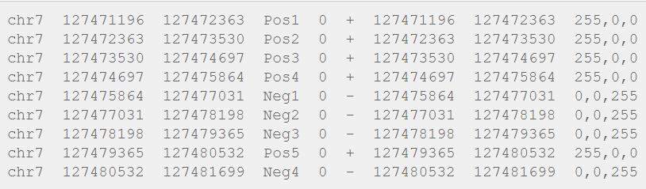
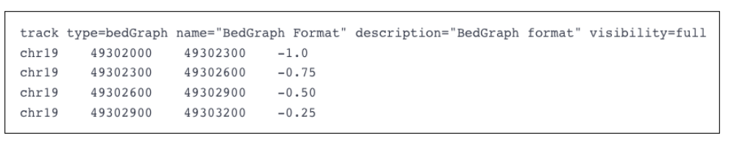
表观组学数据分析中的数据格式2
BED / BigBED / BedGraph
chrom - name of the chromosome or scaffold.
chromStart - Start position
chromEnd - End position
name - Label to be displayed
score - A score between 0 and 1000.
strand - defined as + (forward) or - (reverse).
thickStart - coordinate at which to start drawing the feature as a solid rectangle
thickEnd - coordinate at which to stop drawing the feature as a solid rectangle
itemRgb - an RGB colour value (e.g. 0,0,255).
blockCount - the number of sub-elements (e.g. exons) within the feature
blockSizes - the size of these sub-elements
blockStarts - the start coordinate of each sub-element
BedGraph：连续分布数据是稀疏或者大小有差异
四列，类似于Bed格式，score在第四列
BED是0-based
11

Slide 12
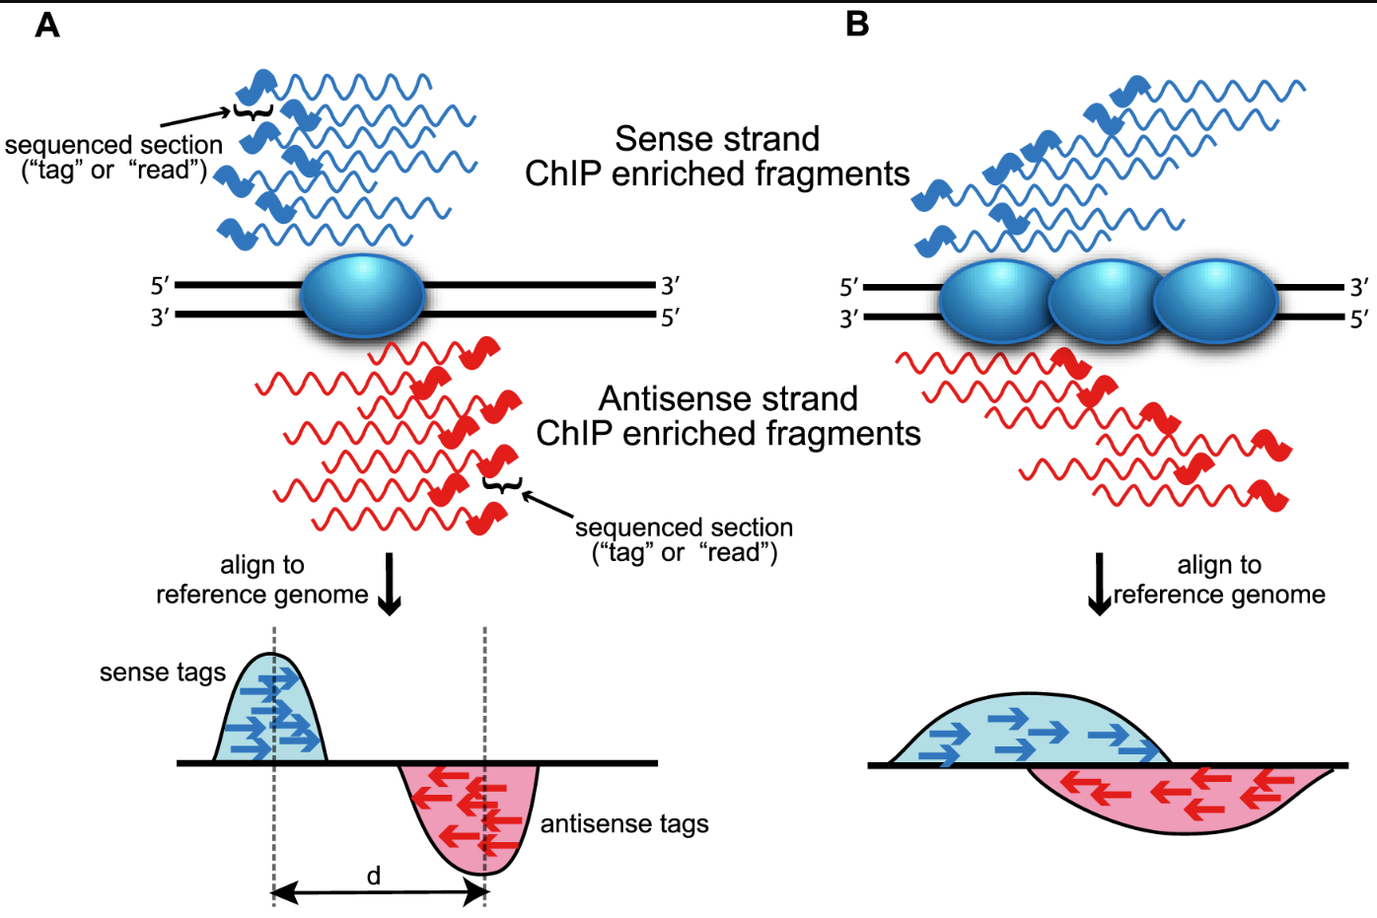
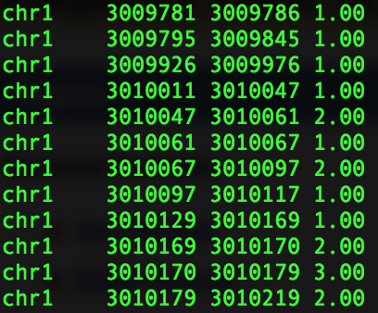
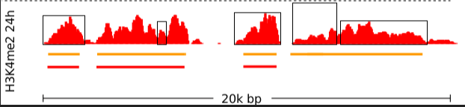
表观组学数据分析中的重要概念 – Peak
蛋白质和DNA的结合位置
ChIP-seq得到的蛋白质和DNA的结合位置
narrowPeak
broadPeak
https://hbctraining.github.io/Intro-to-ChIPseq-flipped/lessons/06_peak_calling_macs.html
Wilbanks, Elizabeth G., and Marc T. Facciotti. "Evaluation of algorithm performance in ChIP-seq peak detection." PloS one 5.7 (2010): e11471.
12

Slide 13
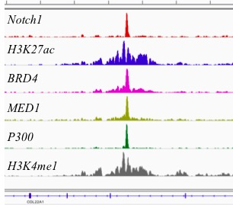
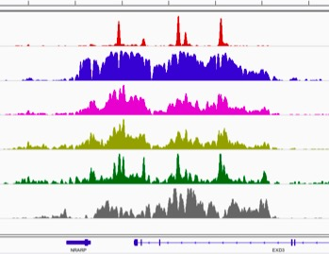
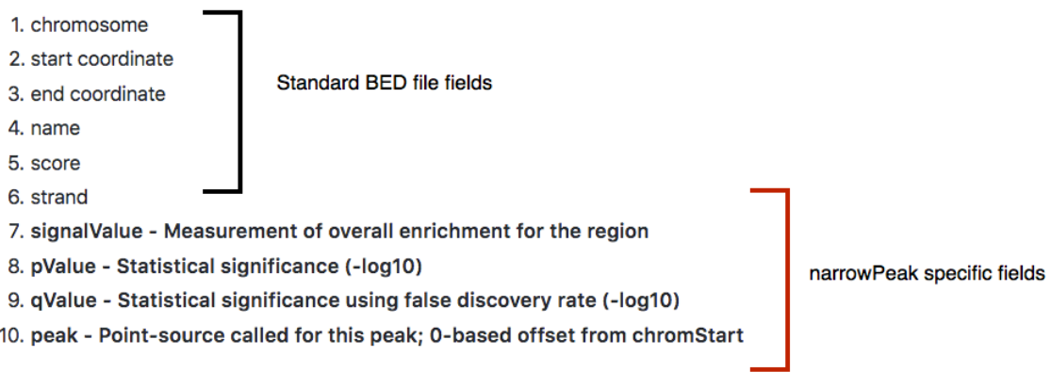
Peak根据宽度不同可分为
narrowPeak
broadPeak
100~200bp
结合位点集中的蛋白质，比如转录因子
>200bp
组蛋白修饰等广泛的染色质状态
https://hbctraining.github.io/Intro-to-ChIPseq-flipped/lessons/07_handling_peaks_bedtools.html

Slide 14
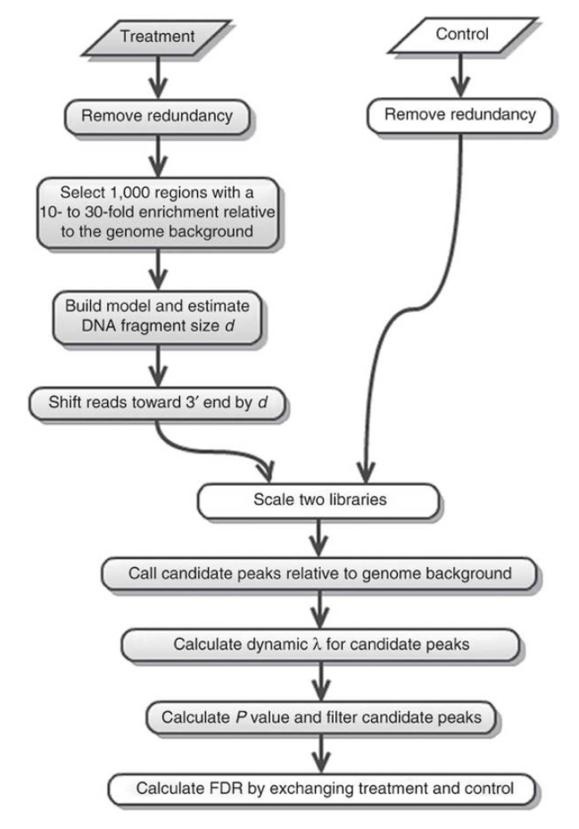
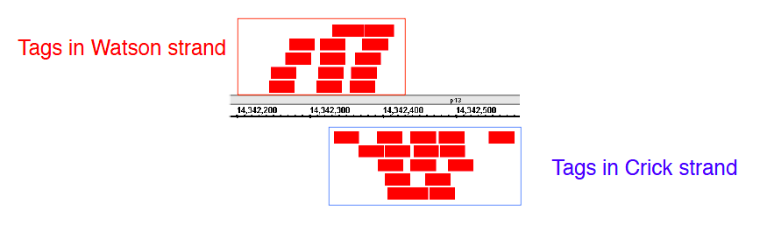
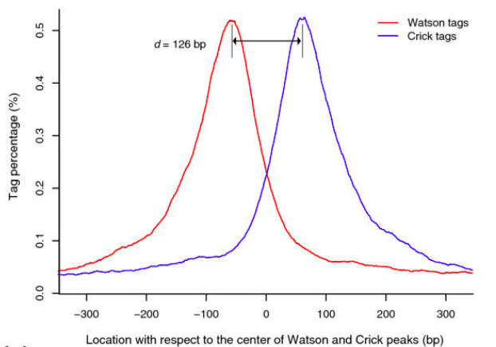
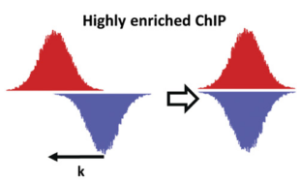
MACS原理简介 – PeakCalling
删除冗余Read (来源于PCR扩增, optional)
根据Fragment长度分布调整Read比对后的位置 (测序仪一般只会从Fragment 5’端进行读取Read → 人为双峰)
目标：估计Fragment长度分布d
随机抽样1000个区域 (10~30倍富集)
分离匹配到正链/负链的Read → 计算分布模式和峰Peak的位置
选取峰值的中点 (正链在左，负链在右)
选取峰值距离 → estimated d
将所有的Read向3’端延申到d的长度 (模拟Fragment在基因组的比对效果)
Single-end → Pair-end ?
Feng, J., Liu, T., Qin, B. et al. Identifying ChIP-seq enrichment using MACS. Nat Protoc 7, 1728–1740 (2012). https://doi.org/10.1038/nprot.2012.101

Slide 15
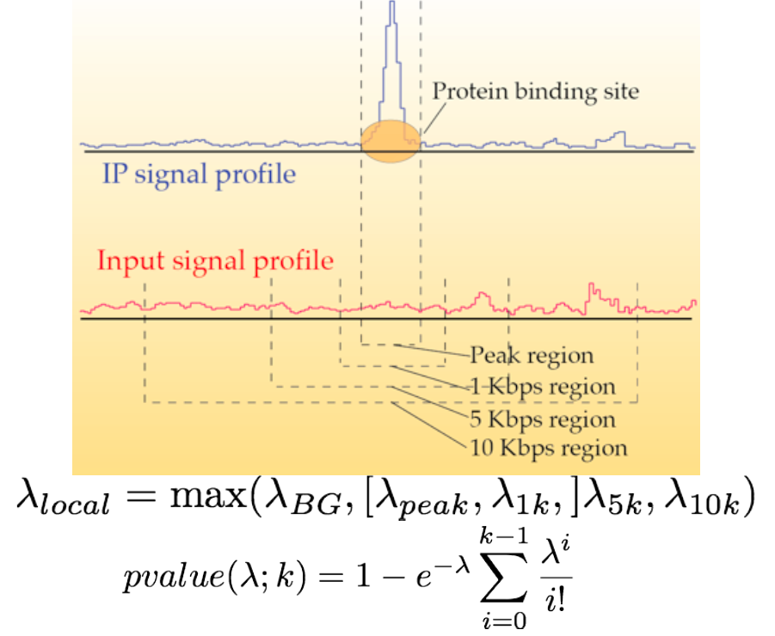
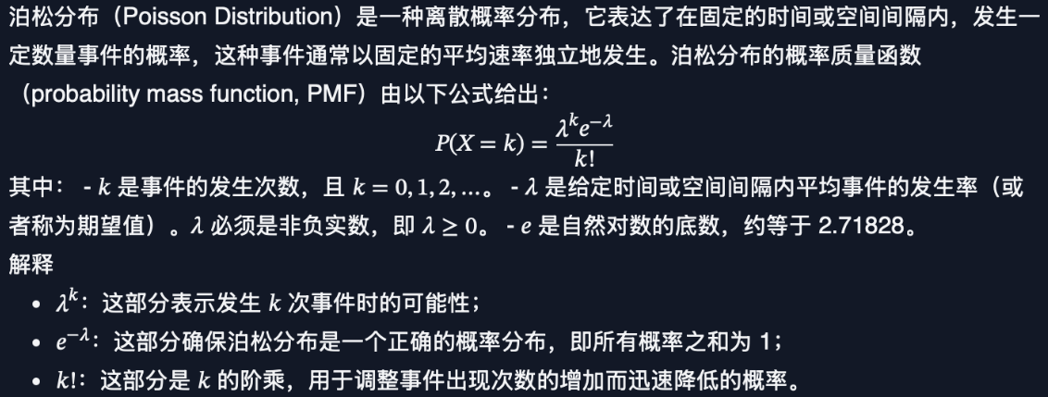
3. 使用局部背景归一化计算峰富集
滑动长度为2d的窗口 → 识别candidate Peak
对于每个candidate Peak，定义背景泊松分布(参数λ) → 计算λ _{local}
基于参数λ 和Peak观测片段个数k 得到显著P-value (MACS计算在泊松分布背景下观察到当前k 或更极端k 的概率)
4. 交换Case/Control样本进行假阳性率估计
Zhang, Y., Liu, T., Meyer, C.A. et al. Model-based Analysis of ChIP-Seq (MACS). Genome Biol 9, R137 (2008). https://doi.org/10.1186/gb-2008-9-9-r137

Slide 16
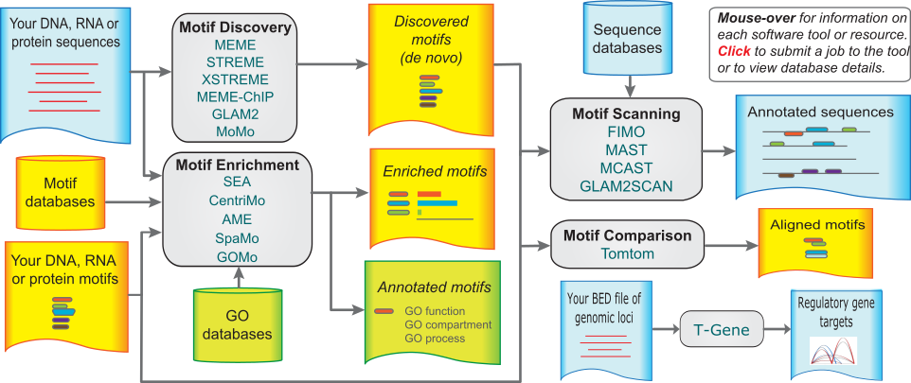
MEME原理简介 – motif analysis
从中挖掘出蛋白质直接结合的短的重复保守序列（motif）
https://meme-suite.org/meme/

Slide 17
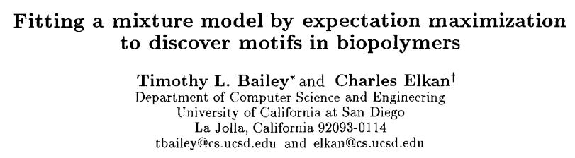
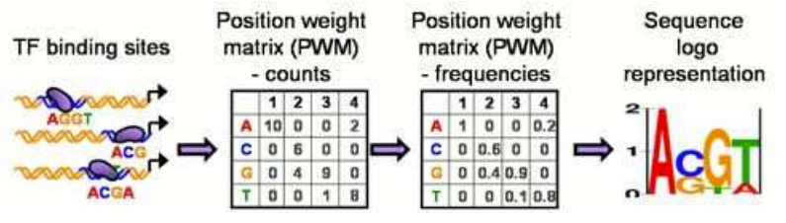
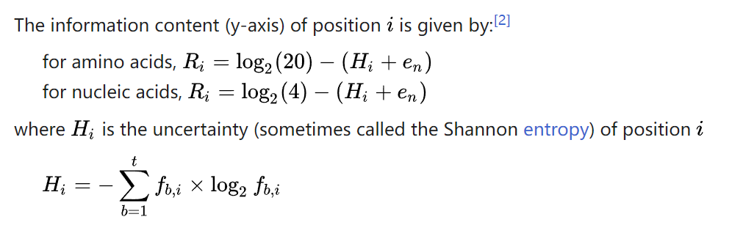
Motif discovery → MEME
如何描述一个TF的motif ?
MEME (Multiple EM for Motif Elicitation→ 混合模型+EM算法)
输入：unaligned sequence + width of the motif
输出：a model of each motif + optimal classifier + alignment of the motif
MEME的设计思路：
Find an initial motif → use EM to improve the motif → until values in PWM do not improve → output
参数：
λ1: motif probability
θ1: letter frequency in the motif (f1, f2, …fW)
λ2: background probability, λ1 + λ2 = 1
θ0: letter frequency in the background
Dataset: X={X1, … Xn}
E-Step:
X + λ (k) + θ (k)→ expected value of log likelihood (design Q function)
M-Step:
Maximize over λ + θ → next estimate λ (k+1) + θ (k+1)
Bailey, Timothy L., and Charles Elkan. "Fitting a mixture model by expectation maximization to discover motifs in bipolymers." (1994): 28-36.

Slide 18
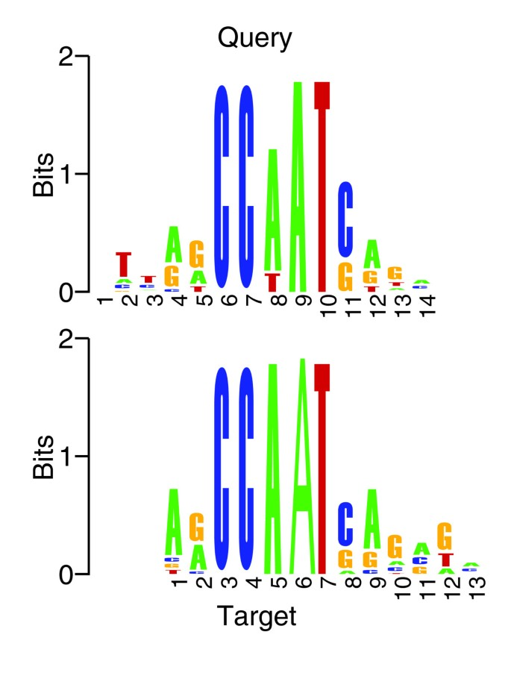
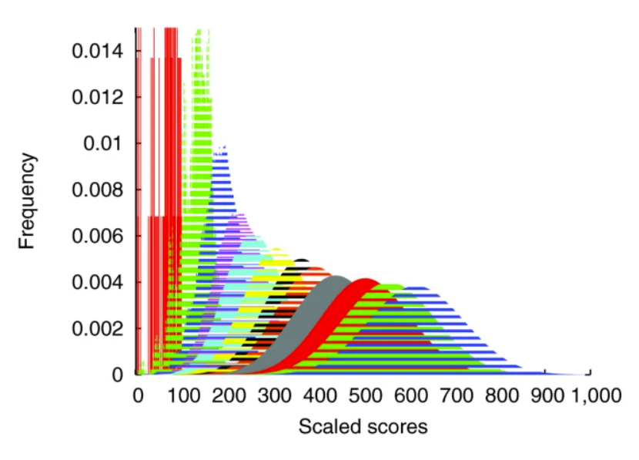
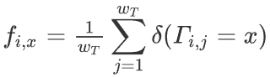
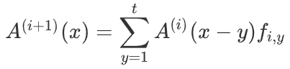
Motif comparison → Tomtom
Comparison algorithm:
PCC, ALLR, PCS, FIET, KLD, ED, or SW
输入：两个motif Q and T
定义：motif comparison function S → S(Q,T) is small if Q and T resemble
难点：offset + orientation + how to combine column comparison s(Qi ,Tj) into a single score + get P-value
Motif Q: width wq, target motifs, T1, … Tn , width wt , wQ-by-wT matrix Γ, Γ _{i,j} = s(Q _{i} ,T _{j} )
Rescale the values in Γ (e.g 1~t=100), round into integers
Compute the frequency of x in the null distribution of the ith column
Initialize a PDF (probability density function) A, perform recursion to calculate the null distribution of summed similarity scores
PDF is converted to a cumulative density function → compute offset P-values
w=12
Gupta, S., Stamatoyannopoulos, J.A., Bailey, T.L. et al. Quantifying similarity between motifs. Genome Biol 8, R24 (2007). https://doi.org/10.1186/gb-2007-8-2-r24
Notes:
ALLR, average log-likelihood ratio; ED, euclidean distance; FIET, Fisher-Irwin exact test; KLD, Kullback-Leibler divergence; PCC, Pearson correlation coefficient; PCST, Pearson χ ² test; SW, Sandelin-Wasserman function.

Slide 19
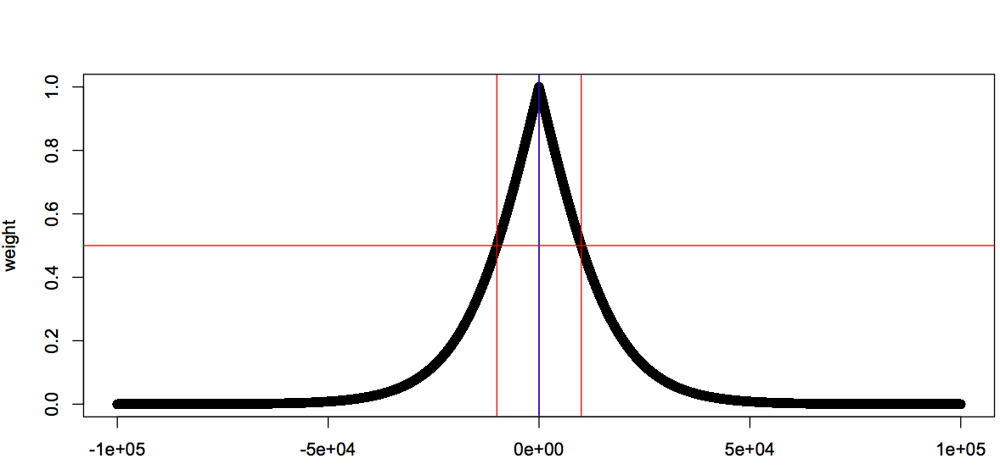
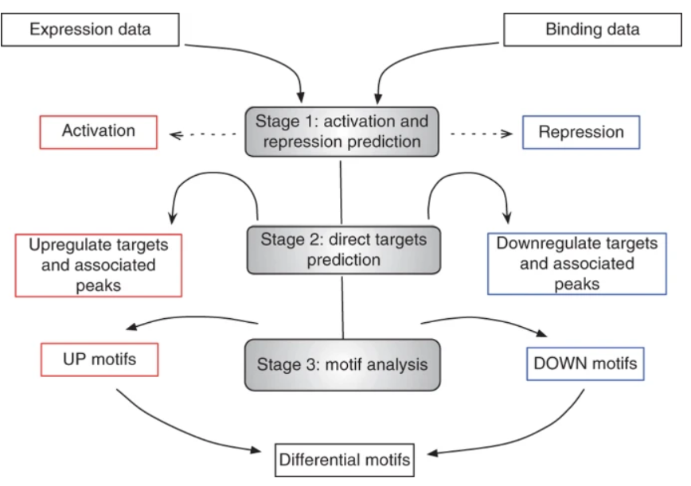
BETA原理简介 – functional analysis
通过ChIP-Seq数据得到与某个蛋白质结合的所有DNA区段(peak) → 如何确定该蛋白质调控的基因 ?
Stage1: 用差异表达+ChIP-seq结合 → 预测TF 是否有激活/抑制的功能
Stage2: 预测TF的靶向基因
Stage3: 结合motif分析得到协同调控TF
基因A的TSS
成为靶基因的可能性
TSS与周围peak之间的距离
Wang, Su et al. “Target analysis by integration of transcriptome and ChIP-seq data with BETA.” Nature protocols vol. 8,12 (2013): 2502-15. doi:10.1038/nprot.2013.150

Slide 20
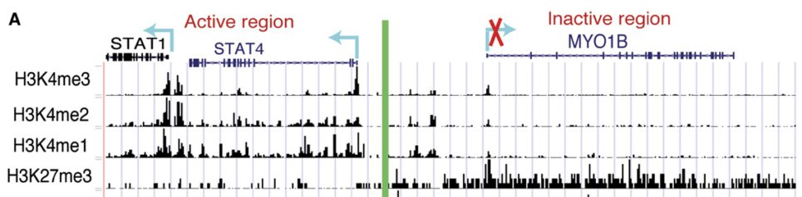
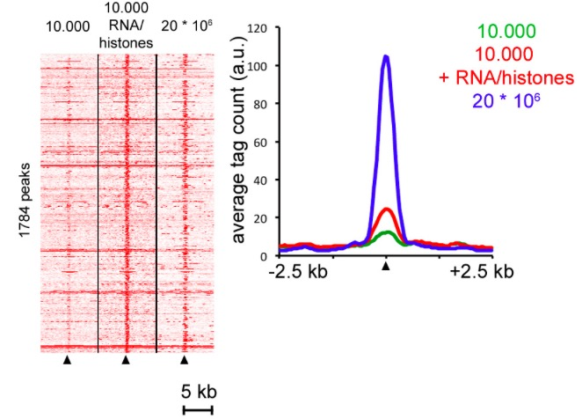
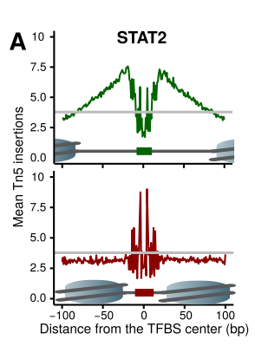
表观组学数据分析中的可视化
反映reads在基因组的分布
反映reads在所有基因的特定区域（如TSS）的分布
反映reads在特定转录因子的分布
(TF foot printing)

Slide 21
第二、三节：单细胞数据分析原理和软件介绍

Slide 22
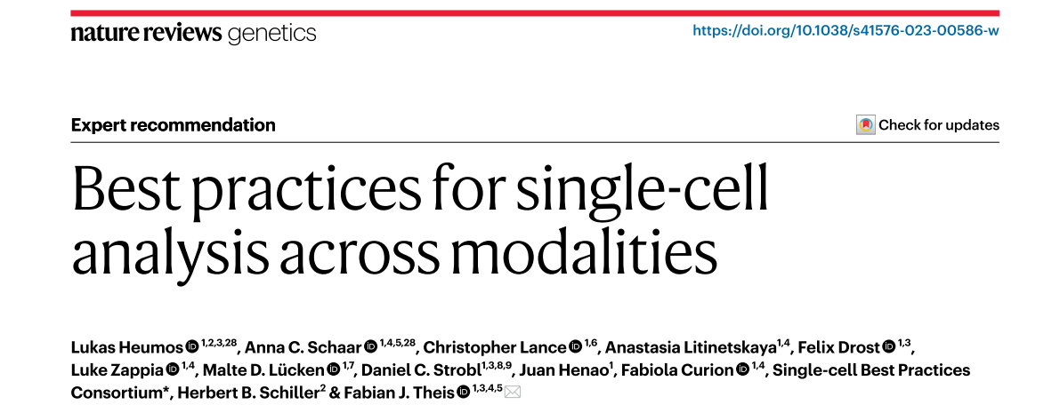

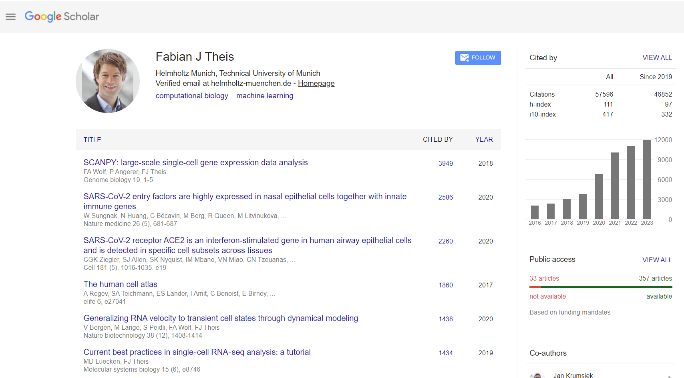
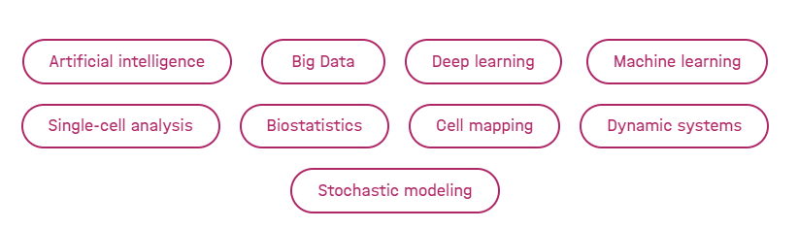
德国慕尼黑亥姆霍兹
https://www.sc-best-practices.org/
Notes:
1计算生物学研究所，计算健康系，德国慕尼黑亥姆霍兹。

Slide 23
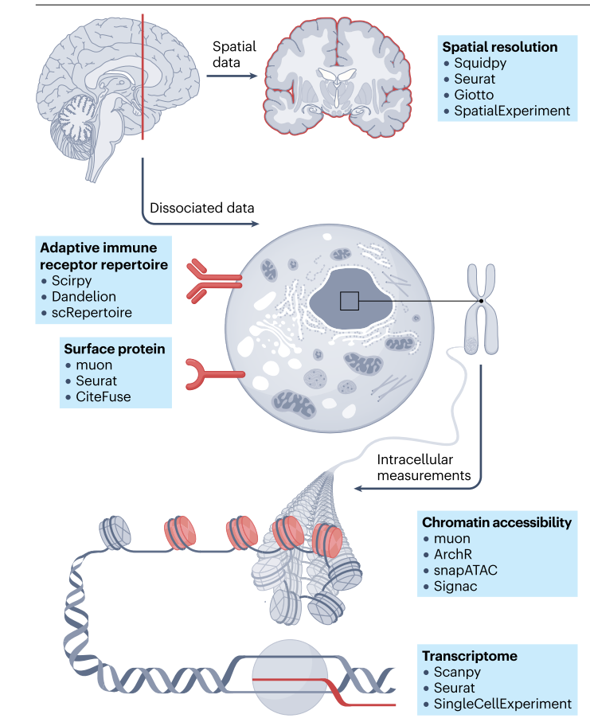
Abstract
Single-cell → high-throughput molecular profiling → across modalities
Single cell
Transcriptomics
Chromatin accessibility
Surface protein expression
Adaptive immune receptor repertoire profiling
Spatial information
Computational methods → best practices
Independent benchmarking
Unimodal and multimodal
https://sc-best-practices.org/

Slide 24
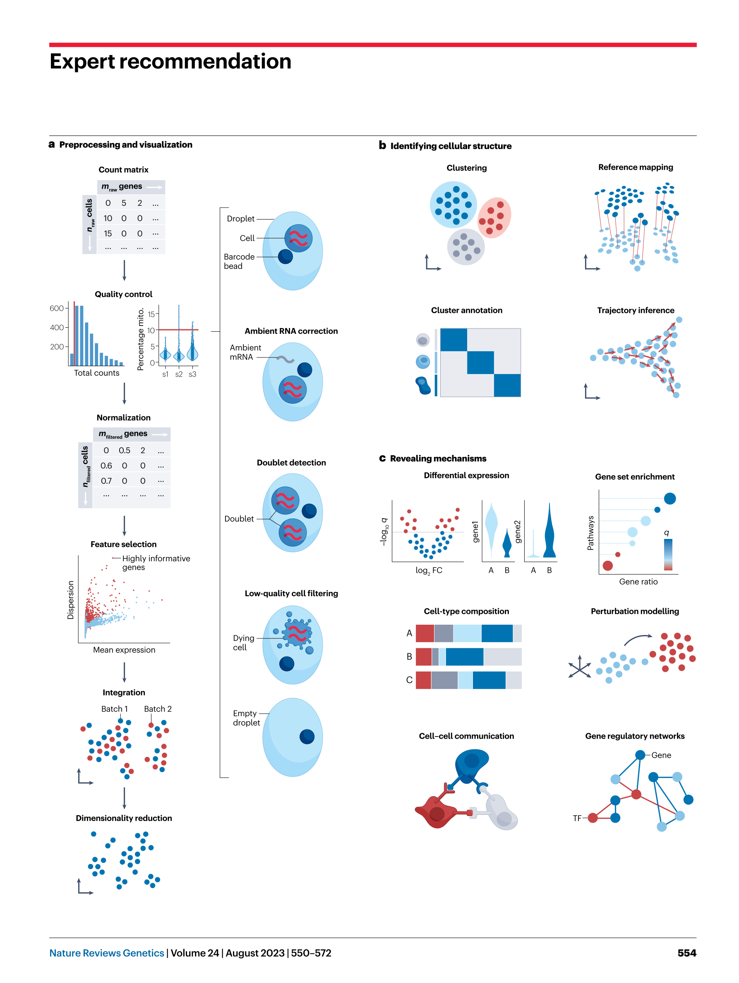
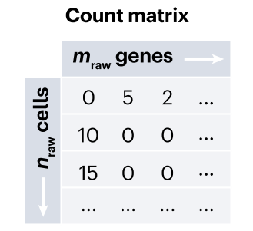
1. Transcriptomics
measures the abundance of mRNA molecules per cell
样本采集
初级数据分析
FASTQ → cellranger
细胞解离
matrix.mtx
genes.tsv
barcodes.tsv
基于微孔板
Plate-based
单细胞分离
RNA提取
基于液滴
Droplet-based
高级数据分析
RNA逆转录扩增
barcode
标识单个细胞来源
建立文库
UMI
标识每个分子来源
用于定量 (去除PCR扩增偏倚)
高通量测序
Notes:
microfluidic droplets微流体液滴

Slide 25
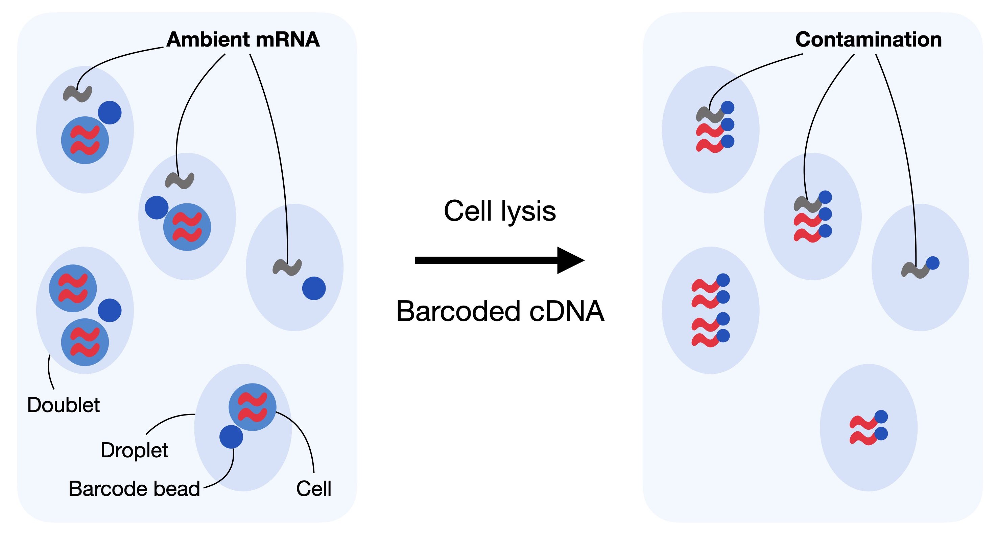
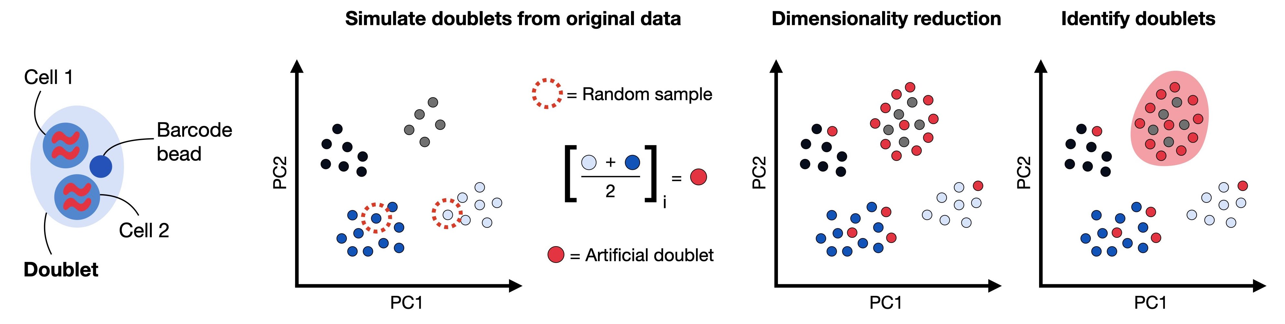
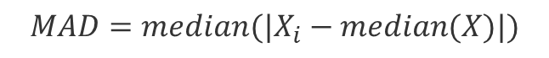
Pre-processing steps → quality control
scRNA-seq data sets = biological signal + systematic noise + random noise
√
each droplet contains RNA from an intact single cell
❌
Ambient RNA → background cell free mRNA in the dilution → lead to cell-type specific marker gene detectable in others, mix populations (soup)
Estimate the composition of the soup and correct the count table
SoupX / CellBender
❌
scDblFinder
Doublets → droplets containing two cells
Combining two randomly samples cells and compare them against measured cells
Low-quality cells → dying cells with broken membranes
a low number of detected genes
a low count depth
a high fraction of mitochondrial/ribosomal/hemoglobin counts
❌
MAD (median absolute deviations)
$$MAD=median(|X_{i}−median(X)|)$$
mt-(mouse) MT- (human)
rps/rpl-(mouse) RPS/RPL- (human)
hb[^p]-(mouse) HB[^P]- (human)
Outlier cells → cells differ by 5 MADs
Gene start with
Notes:
Cells with a relatively high fraction of mitochondrial counts might for example be involved in respiratory processes and should not be filtered out. Whereas, cells with low or high counts might correspond to quiescent cell populations or cells larger in size

Slide 26
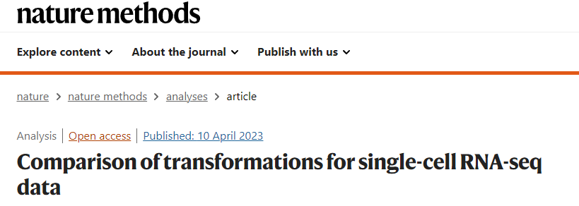
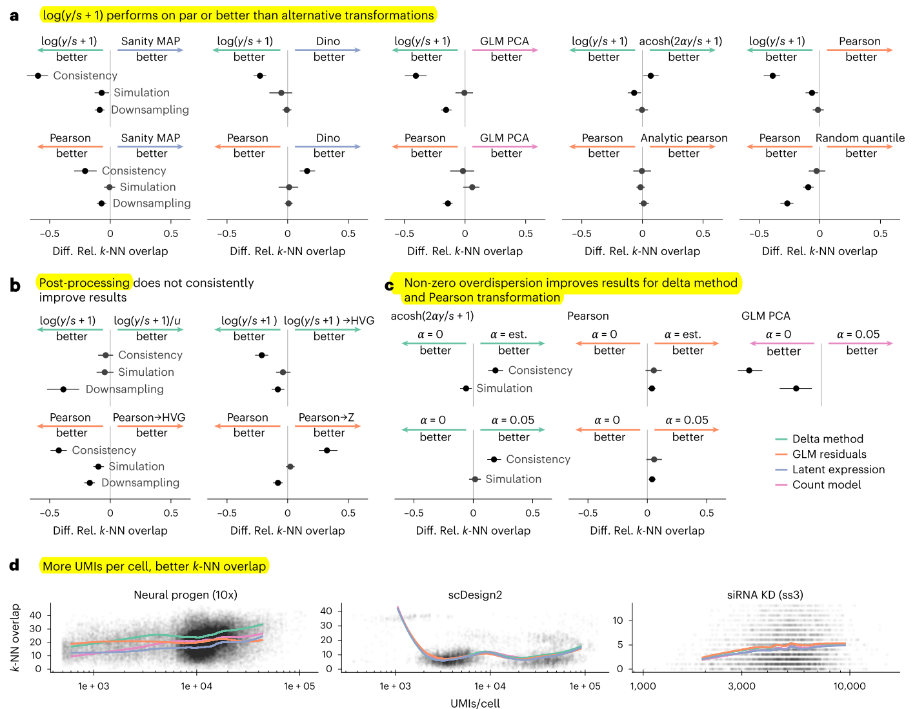
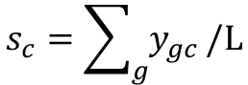
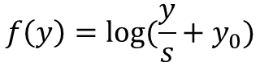
Pre-processing steps → normalization
Gene counts in cell = mRNA volume (cell size) + random
Comparable across cells
y → raw counts
s → size factor
y0 (pseudo-count)
shifted logarithm transformation
stabilizing variance for subsequent dimensionality reduction and identification of differentially expressed genes
$$f\left(y\right)=log⁡(\frac{y}{s}+y_{0})$$
$$s_{c}=\sum_{g}{y_{gc}}/L$$
scran normalization
(delta method)
leverages a deconvolution approach to estimate the size factors based on a linear regression over genes for pools of cells → better for batch correction tasks
analytic approximation of Pearson residuals
fits a generalized linear model with sequencing depth
as a covariate to obtain transformed count matrices → suited for selecting biologically variable genes and identification of rare cell types

Slide 27
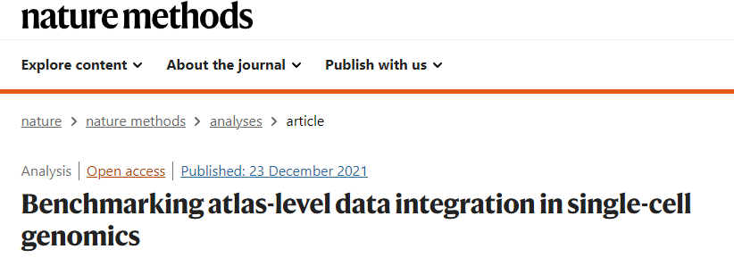
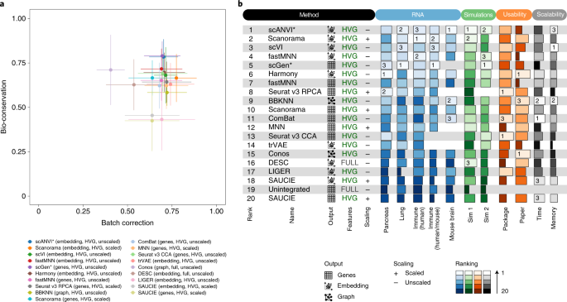
Pre-processing steps → data correction
scRNA-seq data sets = biological signal + technical variation
batch effect removal
Count sampling effects
Linear-embedding models
Harmony (best for simple task)
Simpler integration tasks with distinct batch structures
Deep-learning approaches
scANVI
Incorporate cell type labels → conserve biological variation
Complex integration tasks
scVI/scGen/Scanorama
Biological confounding factors
e.g Cell cycle effects
Seurat (build in cell cycle labeling)
Tricycle

Slide 28







Pre-processing steps → feature selection → dimensionality reduction
scRNA-seq data sets → focus on biologically meaningful genes
Genes vary between (not within) subpopulations
~ 500-5000 selected genes
Rank genes by deviance on raw counts → get top genes
deviance（偏差）
PCA: widely used
tSNE: best overall performance
UMAP: highest stability and separates best the original cell populations
coefficient of variation (highly variable genes)
dispersion（离散度）
average expression level (highly expressed genes)

Slide 29

Task I: clustering and cluster annotation
scRNA-seq data sets → clusters → cell identities
unsupervised machine learning problem
PC-reduced expression space for all cells → Calculate Euclidean distance matrix → connect cells to its K most similar cells (k:5~100) → community detection methods
Louvain algorithm → Leiden algorithm (improved version)
giving detected cell clusters a biological interpretation such as cell type
Classifier-based method
(marker gene/a set genes)
Step1: automated annotation
Step2: manual annotation
Step3: verification for ideal annotation
Reference mapping
Garnett / CellAssign / CellTypist / Clustifyr
scArches/Symphyny/Azimuth
Differential expression (t-test/Wilcoxon rank-sum test) → marker genes
https://ngdc.cncb.ac.cn/celltaxonomy/

Slide 30



Task II: continuous process (trajectory inference)
Discrete states → continuous process
Order cells along a trajectory based on similarities on expression pattern
e.g differentiation
Trajectory inference / pseudo time analysis
Inferred trajectories might not necessarily have biological meaning
Not applicable to steady-state systems/ multiple pronounced kinetics
Cluster approach: 通过聚类的连接构建 pseudotime (e.g MST)
Graph approach: 降维 → 基于graph进行聚类 → 估计聚类的连接 (e.g PAGA)
Manifold-learning based approach: 在cluster approach基础上在高维空间寻找一维的curve连接不同聚类 (e.g Slingshot)
Probabilistic frameworks: 计算细胞间的转移概率 (e.g DPT, diffusion pseudotime)
Topology
RNA velocity
Model splicing kinetics using un-spliced and spliced reads to infer RNA velocity.
velocyto/scVelo
Notes:
transcription rate α, splicing rate β, and degradation rate γ of spliced RNA

Slide 31




RNA velocity of single cells
If a gene is being activated, un-spliced RNA precedes spliced RNA → phase portrait
Un-spliced mRNA
Spliced mRNA
La Manno, G., Soldatov, R., Zeisel, A. et al. RNA velocity of single cells. Nature 560, 494–498 (2018). https://doi.org/10.1038/s41586-018-0414-6

Slide 32

Un-spliced mRNA
Spliced mRNA
稳态模型
ds/dt=0, β=1 → γ=u/s, α=u
u(unspliced)=γ(降解速率)*s(spliced)
统计每个细胞的每个基因进行剪接（Spliced）和未剪接（unSpliced）reads的计数
使用稳态模型，根据以上计数估算降解速率 γ
使用估算的降解速率 γ + 未剪接（unSpliced） reads 的数量估算每个细胞下一个时刻剪接（Spliced） mRNA 的量，认为这是该细胞下一步的状态
对每个细胞下一步的状态与其他细胞进行相关性分析 → 得到该细胞在降维聚类图上下一步的方向
La Manno, G., Soldatov, R., Zeisel, A. et al. RNA velocity of single cells. Nature 560, 494–498 (2018). https://doi.org/10.1038/s41586-018-0414-6
Notes:
https://zhuanlan.zhihu.com/p/668637347

Slide 33

https://zouter.shinyapps.io/server/

Slide 34

Lineage tracing
infer lineage, or ancestry relationships between observed cells
Variability observed in cells → e.g genetic mutations → cell division history in a clonal population
Cassiopeia
LineageOT (static barcode lineage tracing)
Prospective lineage tracing trace the descendants of a single cell → introduce a heritable marker into a cell that is passed on from generation to generation.
Retrospective lineage tracing use variability observed in cells - such as naturally occurring genetic mutations - to infer a model of their lineage (or “phylogeny”) summarizing the cell division history in a clonal population.

Slide 35


Task III: revealing mechanisms: Differential expression
Negative binomially distributed scRNA-seq dataset
Sample-level view
Sample-label combination → pseudobulks
edgeR/DEseq2/limma
Cell-level view
MAST
Model cells individually using generalized mixed effect models

Slide 36

Task III: revealing mechanisms: Gene set enrichment
Gene set databases: MSigDB/Gene ontology/KEGG/Reactome
Tools for Weighted gene sets: PROGENy
Tools for Signally pathways: DoRothEA
Can be applied to scRNA-seq
Tools for single cell methods: Pagoda2

Slide 37

Task III: revealing mechanisms: Cell-type composition
Composition for development and disease
Change in abundance for each cell type individually: Possion regression / Wilcoxon rank-sum tests
Tests for single cell data incorporate hierarchical cell type information: scDC / scCODA / tascCODA
Tests for developmental data with sharp clustering boundaries: DA-seq / MILO

Slide 38


Task III: revealing mechanisms: Perturbation modeling
Massively multiplexed experiments → measure hundreds of thousands of cells under thousands of unique conditions → Perturbation → e.g profile CRIPSR-Cas9 / genome-wide perturbations / combinatorial perturbations
Perturb-seq
CROP-seq (CRISPR-Associated RNA-Seq)
特异性靶向和编辑特定基因(Perturb-seq: gRNA → barcode, CROP-seq: gRNA)+RNA测序技术来分析被调控基因的表达变化 → 在单细胞水平上进行分析 → 允许观察基因敲除或敲低对整个转录组的影响
Augur: Find the cell types that were most affected by perturbations
scGen: predicting the transcriptional response of single cells to perturbations
Adamson, Britt, et al. "A multiplexed single-cell CRISPR screening platform enables systematic dissection of the unfolded protein response." Cell 167.7 (2016): 1867-1882.
Datlinger, Paul, et al. "Pooled CRISPR screening with single-cell transcriptome readout." Nature methods 14.3 (2017): 297-301.
Mixscape: quantifying the sensitivity of genetic CRIPSR perturbations
Notes:
https://www.nature.com/articles/s41587-023-02003-3
Perturb-Seq

Slide 39




Task III: revealing mechanisms: Cell-cell communication
Secreted ligand binding to its corresponding plasma membrane receptor → predict interactions between annotated clusters
Ligand-receptor interactions
LIANA (framework)
Include downstream response
Nichenet
Browaeys, R., Saelens, W. & Saeys, Y. NicheNet: modeling intercellular communication by linking ligands to target genes. Nat Methods 17, 159–162 (2020). https://doi.org/10.1038/s41592-019-0667-5
Find ligand-receptor interactions specific to cell type pairs → induce cell-type specific signal transduction changes

Slide 40



2. Chromatin accessibility
Cellular diversity and cell decision making (epigenetics and chromatic accessibility)
DNA甲基化 / 组蛋白修饰 / 转录因子活性 → 驱动基因表达 → 细胞鉴定
Chip-Seq
组蛋白修饰
H3K4me1和H3K27ac：与增强子区域相关；
H3K4me3：与启动子区域相关；
H3K36me3：与基因体中的转录区域相关；
H3K27me3：与 Polycomb 抑制相关；
H3K9me3：与异染色质相关。
ATAC-Seq
DNA转座酶Tn5
Nakato, Ryuichiro, and Toyonori Sakata. "Methods for ChIP-seq analysis: A practical workflow and advanced applications." Methods 187 (2021): 44-53.
Grandi, Fiorella C., et al. "Chromatin accessibility profiling by ATAC-seq." Nature protocols 17.6 (2022): 1518-1552.
Notes:
Cut-tag

Slide 41


scChIP-Seq
微流体工作流程
Rotem, A., Ram, O., Shoresh, N. et al. Single-cell ChIP-seq reveals cell subpopulations defined by chromatin state. Nat Biotechnol 33, 1165–1172 (2015). https://doi.org/10.1038/nbt.3383
scATAC-Seq
微流体工作流程
Lareau, C.A., Duarte, F.M., Chew, J.G. et al. Droplet-based combinatorial indexing for massive-scale single-cell chromatin accessibility. Nat Biotechnol 37, 916–924 (2019). https://doi.org/10.1038/s41587-019-0147-6

Slide 42


单细胞表观测序的数据优势
cis-regulatory elements (CREs)
Preissl, S., Gaulton, K.J. & Ren, B. Characterizing cis-regulatory elements using single-cell epigenomics. Nat Rev Genet 24, 21–43 (2023). https://doi.org/10.1038/s41576-022-00509-1
Notes:
https://www.nature.com/articles/s41576-022-00509-1

Slide 43

单细胞表观测序的数据分析软件流程 (scChIP-Seq)
https://github.com/vallotlab/scChIPseq_DataEngineering

Slide 44

单细胞表观测序的数据分析软件流程 (scATAC-Seq)
读入数据
质量控制
定义特征
降维聚类
细胞注释
可视化
深入解读

Slide 45


Pre-processing steps → Quality control
Total fragment counts ~ number of total counts in scRNA-seq
TSS enrichment: ratio of fragments centered as TSS to fragments in TSS flanking regions → signal-to-noise ratio of each cell
Number of features per cell ~ number of genes in scRNA-seq
Nucleosome signal: ratio of mono-nucleosomal to nucleosomal-free fragments → signal-to-noise in each cell
Reads in peaks fraction: fraction in peak regions vs. outside of peaks → signal-to-noise ratio
Blacklist fraction: ENCODE black regions → artefactual signal
QC: Doublets
scDBlFinder: make count data more continuous
AMULET: high number of positions with more than two counts

Slide 46




Task I: clustering and cluster annotation
Normalization
Binarization of peaks (optional, 不保留原始信号强度，只标记开放/关闭)
Latent semantic indexing ArchR / Signac
Dimension reduction
Latent Dirichlet allocation cisTopic
Spectral embedding snapATAC
Batch correction
LIGER / PeakVI / MultiVI
Module detection
Leiden clustering
DESeq2 / edgeR
Differential testing methods
Differentially accessible regions (DARs)
Confounder: total counts / TSS score
GREAT / LOLA / GIGGLE
DARs → cis-regulatory elements (CREs) → proximal genes → Gene activity scores → cell type annotation
MAGIC

Slide 47



Task II: TF motifs and foot printing
Schep, A., Wu, B., Buenrostro, J. et al. chromVAR: inferring transcription-factor-associated accessibility from single-cell epigenomic data. Nat Methods 14, 975–978 (2017). https://doi.org/10.1038/nmeth.4401
Footprints → putative TF binding sites
chromVAR: aggregates chromatin accessibility across peaks that share a common feature (e.g motif) → apply bias correction to generate scores for each cell → TF-motif enrichment scores
→ cell type annotation
scATAC-seq → validation of the TF impact through foot printing → whether the TF is binding in the given cell cluster
ArchR:
TF foot printing analysis

Slide 48

chromVAR: inferring transcription-factor-associated accessibility from single-cell epigenomic data
计算每个细胞每个Peak的期望片段E (特定Cell中片段分布按照所有细胞的片段总数分布进行分配)
计算观测片段数和期望的偏差 Y
对每个Motif，选取匹配GC content+可及性信号的Peaks作为背景 → 计算得到背景偏差Y’
计算得到矫正的偏差 Z-score → motif * cell矩阵
下游分析 → 细胞聚类/motif差异可及性分析/TF-motif在所有细胞中的易变性分析/TF协同分析
Schep, A., Wu, B., Buenrostro, J. et al. chromVAR: inferring transcription-factor-associated accessibility from single-cell epigenomic data. Nat Methods 14, 975–978 (2017). https://doi.org/10.1038/nmeth.4401

Slide 49


Task III: linking single-cell chromatin accessibility and transcriptomics
10X multiome, sci-CAR, sCAT-seq
MOFA+ : paired integration
Different modalities measured independently → unpaired data
SCOT / UnionCom / GLUE : un-paired integration → reduce inter-modality information loss
totalVI / MultiVI: mosaic integration (CITE-seq / Multiome data)
Stabmap / Multigrate: impute missing modalities
Multigrate: map unimodal and multimodal query datasets to multi-omics reference and imputing missing modalities

Slide 50


3. Surface protein expression
Gene products → proteins → some presented on the cell surface
e.g such as haematopoietic cells (造血细胞) of the immune system
ADTs: antibody-derived tags → quantify surface protein expression levels
被测序测到的“从抗体衍生出来的标签”
CITE-seq
通过测序对转录组和表位进行细胞索引
将条形码与 RNA 一起进行测序
Choi, Jane Ru, et al. "Single-cell RNA sequencing and its combination with protein and DNA analyses." Cells 9.5 (2020): 1130.
Notes:
"AbBs" 是 "Antibody Barcoding" 的缩写

Slide 51
Pre-processing steps → Quality control
ADT data → less sparse → ambient contamination and nonspecific antibody binding
Most cells → e.g 70~140 proteins
Total counts per cell ~ number of total counts in scRNA-seq → remove droplets
Number of proteins per cell ~ number of genes in scRNA-seq
Empty droplets → estimate a background noise and remove the ambient noise
Background population mean and isotypes (antibodies that bind non-specifically to the cells) → remove cell-to-cell technical noise
CLR: Centered Log-Ratio transformation
DSB: Denoised and scaled by background → low level normalization method

Slide 52

Task: jointly analyzing transcriptomics and ADT data
ADT data → similar as scRNA-seq
totalVI: joint embedding
CiteFuse: similarity network fusion algorithms
Notes:
https://academic.oup.com/bioinformatics/article/36/14/4137/5827474

Slide 53



4. Adaptive immune receptor repertoire profiling
T细胞受体（TCR）和B细胞受体（BCR）
adaptive immune receptor repertoire → transmembrane surface protein complexes → TCRs/ BCRs
AIRR
适应性免疫组库 → 识别和结合特定的抗原 → 触发免疫反应
B细胞的主要功能是产生并分泌抗体（免疫球蛋白），这些抗体能够识别并结合特定的抗原（病原体或其他外来物质），从而中和或清除它们
T细胞在适应性免疫系统中扮演着重要的角色，负责识别和攻击被感染细胞、肿瘤细胞以及其他异物
TCR
抗原识别 → B细胞激活增殖 → 分化为浆细胞 → 分泌大量抗体 antibody → 形成记忆B细胞
抗原呈递细胞(树突状细胞) → 呈递给T细胞 → TCR与抗原结合 → T细胞激活增殖 → 功能性T细胞 → 分化为细胞毒性T细胞（CD8+ T细胞）和辅助性T细胞（CD4+ T细胞）
BCR
TCR 是一个异源二聚体
95%的TCR由α链和β链通过二硫键连结构成
免疫球蛋白(immunoglobulin，Ig)
两条相同的重链和两条相同的轻链通过链间二硫键连接而成的四肽链结构
轻链：可变区（V区）+ 恒定区（C区）
重链：可变区（V区）+ 恒定区（C区）+跨膜区+胞质区

Slide 54


可变区（V区）→ N端 决定抗原识别特异性
恒定区（C区）→ C端 参与信号传导功能
V区：
互补决定区（Complementary Determining Region，CDR）→ 形成与抗原表位互补的空间构象 CDR1 / CDR2 / CDR3(多样性最高，与抗原结合)
框架区(framework region，FR) → 稳定CDR区空间构象
TCR的基因
TRA: TCR α chain → V + J → TRAV + TRAJ
TRB: TCR β chain → V+D+J → TRBV + TRBD + TRBJ
BCR的基因
IGK/IGL: Ig light chain → V+J → IGK(L)V + IGK(L) J
IGH : Ig heavy chain → V+D+J → IGHV + IGHD + IGHJ
T/B细胞在发育过程中V、D、J基因重排 → 每个T/B细胞的TCR/BCR编码基因不一样

Slide 55






Pipeline: scRepertoire
Pipeline: scirpy
10x Chromium Single Cell Immune Profiling
BD Rhapsody TCR/BCR Multiomic assays
Pipeline: Dandelion

Slide 56


Pre-processing steps → Quality control
鉴定出真实包含T细胞或B细胞的Barcode
预期每个B细胞有一条可翻译（productive）的重链和一条可翻译的轻链，预期每个T细胞有一条可翻译的α链和一条可翻译的β链
Fastq Reads→每个T细胞或B细胞的V(D)J转录本序列
将组装contig先比对到参考序列的V基因、D基因，J基因，C基因及5'UTR区域
注释出每条contig的CDR3区
判定contig是否为全长序列 (full length)
是否可翻译成有功能的蛋白质 (productive)

Slide 57


Task I: AIRR sequence analysis
扫描谱型
每个细胞两条链CDR3氨基酸序列相同则定义为同一种克隆型 → 统计克隆性分布
对每个基因统计CDR3长度 → 绘制分布图
正常情况 →正态分布
机体参与针对抗原的免疫反应 (免疫缺陷病、免疫反应性疾病或肿瘤) → 某种长度的CDR3克隆性增加 + 偏离正态分布
对每条链（T细胞：α链TRA+β链TRB；B细胞：轻链λ链IGL+轻链κ链IGK+重链IGH）→ CDR3氨基酸序列长度进行分组 → 并对各个长度的CDR3氨基酸序列分别进行Motif分析
选择性基因片段 → 丰度检测
如果一个基因片段丰度高 → 高度选择的免疫受体
评估治疗反应效果
揭示免疫多样性在疾病中作用
扩增T/B → 近期免疫应答 Biomarker
Clonotype → 相同的V基因 + 相同的VJ + VDJ CDR3 氨基酸序列
根据序列相似性构建系统发生树
患者特异的Clonotype → 精准治疗
检测疾病状态
开发新的免疫治疗策略

Slide 58

Task II: Specificity and Integrating analysis
AIR-antigen interaction → CDR3 from VDJ chain / CDR3 from VJ chain → AIRs with similar sequence are likely to have common specificity
AIRR sequencing +
Surface protein +
Transcriptomics measurements
Cell fate following infection or vaccination
AIR → separate immune cell clusters and T cell type annotation
T cells is driven by an epitope sequence and the entire AIR–epitope complex
1. Database query: IEDB / PIRD / vdjDB (TCRs only) / SAbDab (BCRs only)
2. Sequence similarity: TCRdist / TCRmatch
Joint annotations and visualizations
3. Predict between AIRs and an epitope: ERGO-II
TCR data: TESSA / mvTCR / Conga
BCR data: Benisse

Slide 59




5. Spatial information
Pipeline: Squidpy
Pipeline: Giotto
Pipeline: Seurat
Pipeline: SpatialExperiment

Slide 60


Pre-processing steps → get count matrices and spatial coordinates of cells
基于图像的方法
Cell segmentation
Directly assign cell labels to spatially proximal pixels (SSAM / Baysor)
Incorporate cell-shape information →
enhance segmentation results
基于芯片的方法
非single-cell resolution
Decompose gene expression profiles
(Cell2location / SpatialDWLS / RCTD / Spotlight)
Deconvolution (spotlight)

Slide 61

反卷积(Deconvolution)算法 SPOTlight -- seeded NMF regression to deconvolute spatial transcriptomics spots with single-cell transcriptomes
NMF: Non-negative matrix factorization → 非负矩阵分解 (将矩阵分解为两个或多个非负元素的低维矩阵)
NNLS: non-negative least squares → 非负最小二乘法
N: scRNASeq的细胞总数
M: 空转中位置(spot locations)个数
G: scRNASeq中的细胞类型marker基因+3000最大变异度基因
G’: 空转中所有基因
Gi：G和G’交集
C: scRNASeq中所有细胞类型 / K: Topic个数 (降维参数)
V: Gi*N scRNASeq数据矩阵 / V’: Gi*M 空转数据矩阵
P: C*M 细胞类型在不同spot的权重矩阵
W: Gi*K → gene在所有Topic中的分布矩阵
H: K*N → Topic在所有细胞中的分布矩阵
H’: K*M → Topic在所有spot中的分布矩阵
Q： K*C → Topic在所有细胞类型中的分布矩阵
已知：V / V’/Gi 未知：W / H / H’/ Q 目标：P
NMF: V (Gi*N) ~ W(Gi*K)*H(K*N) → 得到 W、H
NNLS: V’(Gi*M)~ W(Gi*K)*H’(K*M) → 得到 H’
根据细胞类型注释 从H(K*N) → Q(K*C)
NNLS: H’(K*M) ~ Q (K*C) * P (C*M) → 得到P
H’ (K*M)
Q (K*C)
Marc Elosua-Bayes, Paula Nieto, Elisabetta Mereu, Ivo Gut, Holger Heyn, SPOTlight: seeded NMF regression to deconvolute spatial transcriptomics spots with single-cell transcriptomes, Nucleic Acids Research, Volume 49, Issue 9, 21 May 2021, Page e50, https://doi.org/10.1093/nar/gkab043
P (C*M)
Notes:
https://www.sc-best-practices.org/spatial/deconvolution.html

Slide 62



Slide 63



Task I: Cell identity and cellular microenvironments
Imputation: Imputes undetected transcripts in spatial samples by optimizing the gene-wise similarity between spatial and scRNA-seq data (Tangram)
Similarity between cells → Cell cluster → identify cell identity:
Spatial dependencies of gene expression (Squidpy / HMRF / BayesSpace)
Incorporates from histological image (spaGCN / stLean)
Align image between different samples → Microenvironment analysis
(Tangram / GridNet / eggplant)
Notes:
https://www.sc-best-practices.org/spatial/imputation.html

Slide 64




Task II: spatial patterns and communication events
Highly variable genes / DGE → spatially variable genes (SVGs)
Leverage spatial correlation test: SPARK / SpatialDE
Markov random fields: BayesSpace
Graph neural networks to integrate gene expression data + spatial information + histology images: spaGCN
Diffusion-based modelling to identify genes with spatial patterns: sepal
Spatial cell-cell communications → compare gene expression pattern based on the surrounding neighboring cells (GCNG / Misty / NCEM / SpaOTsc / SVCA)

Slide 65


Spateo开发：研究者开发了一个名为Spateo的3D时空建模框架，用于量化胚胎发生过程中的时空动态，这对于理解先天性疾病至关重要。
3D重建：Spateo能够重建小鼠胚胎在E9.5和E11.5阶段的3D地图和模型，捕捉了800万个细胞。
分子全息图：通过可扩展的部分非刚性对齐、多切片精细化和网格校正，Spateo创建了整个胚胎的分子全息图。
3D数字化和细胞通讯：Spateo揭示了空间梯度和信号通路，通过3D数字化和细胞间通讯，识别了沿3D结构正交轴的表达梯度，例如中脑-后脑边界（MHB）等次级组织者。
信号景观建模：Spateo进一步联合建模细胞间和细胞内相互作用，以解析3D结构中的信号景观，包括视隔限界（ZLI）。
形态测量矢量场：Spateo引入了细胞迁移的“形态测量矢量场”，并将空间微分几何整合进来，揭示了小鼠心脏不对称形态发生的分子程序，将宏观变化与分子动态联系起来。
器官生态学研究：Spateo使得研究者能够在3D空间和时间上，从分子层面研究器官生态学。

Slide 66
单细胞数据分析总结
Transcriptomics
Chromatin accessibility
Surface protein expression
Adaptive immune receptor repertoire profiling
Spatial information

Slide 67


单细胞组学(转录组and/or表观组)研究基因转录调控
基因调控网络（GRNs）
GRN可以从组学数据中推断出来，并通过额外信息 (如TF结合预测或染色质可及性) 进行优化
GRN的节点是TFs及其调控的基因，节点之间的边表示调控模式（激活或抑制）
特定细胞类型和细胞状态的原因 (重构rewiring)
解释动态轨迹的驱动TF
识别不同条件之间的核心差异驱动元件
Badia-i-Mompel, P., Wessels, L., Müller-Dott, S. et al. Gene regulatory network inference in the era of single-cell multi-omics.
Nat Rev Genet 24, 739–754 (2023).

Slide 68


生物学网络的基本概念
Graph: G=(V,E)
Subgraph G’=(V’,E’)
Nodes(vertices/points): N
V={PRO31,RET1,…,RPA135}
Total number → Size
Edges(arcs/links): E
E={{RET1,RPO31},{PRO31,PRC40}…
Direction
Weight
Adjacent matrix: A(N*N)
Walks
Paths
Shortest Paths
Cycle
Neighbors
Distance
Component
Module
Motif
Degree/Connectivity: k
hub
Assortativity: knn
Cluster coefficient: C
Scale-free → power-law degree distribution
Small-world → high clustering coefficient
Betweenness: b
Disassortativity → Heterogeneous degree–degree correlation
Notes:
Assortativity同配性

Slide 69

如何构建基因转录调控网络 ?
GRN推断：利用计算方法将基因调控从数据中总结为可解释的网络结构
假设：TF产生的影响(靶向调控的基因)可以在组学数据中观测和测量
有向网络 Vs. 无向网络 / 有权网络 Vs. 无权网络
Bulk
通过转录组学
WGCNA / ARACNe
通过表观组学
ChIP-Seq/CUT&Tag: TF+靶基因
ATAC-Seq: 注释CRE(TF) + 靶基因
Single Cell
通过转录组学
SCENIC/scMINER/…..
通过多模态 (SCENIC+)
TF表达→ 靶基因
注释CRE(TF motif)
CRE → 靶基因：基因组距离 10kb/100kb/<1000kb
TF-CRE-gene (靶基因) → 数据建模 (线性/非线性关系)
cisTarget/DEM/HOMER
Badia-i-Mompel, P., Wessels, L., Müller-Dott, S. et al. Gene regulatory network inference in the era of single-cell multi-omics. Nat Rev Genet 24, 739–754 (2023).

Slide 70


ARACNe: An Algorithm for the Reconstruction of Gene Regulatory Networks in a Mammalian Cellular Context
Step1: 计算基因 i 和基因 j 表达profile的互信息 MI
I(x, y) = S(x) + S(y) - S(x, y)
S(t) is the entropy of an arbitrary variable t
Randomly shuffle the expression of genes across the various microarray profiles → assign a p-value (10^-4)
Step2: 去除indirect candidate interactions
运用信息论中的Data Processing Inequality (数据处理不等式) 原理
→ infer the most likely path of information flow
I(g1, g2) >I(g1, g3) and I(g2, g3) >I(g1, g3) → 去除 g1 <-> g3
I(g2, g3) >I(g2, g4) and I(g3, g4) >I(g2, g4) → 去除g2 <-> g4.
I(g1, g2) >I(g1, g4) and I(g2, g4) >I(g1, g4) 或者 I(g1, g3) >I(g1, g4) and I(g3, g4) >I(g1, g4) → 去除 g1<->g4
Margolin, A.A., Nemenman, I., Basso, K. et al. ARACNE: An Algorithm for the Reconstruction of Gene Regulatory Networks in a Mammalian Cellular Context. BMC Bioinformatics 7 (Suppl 1), S7 (2006). https://doi.org/10.1186/1471-2105-7-S1-S7

Slide 71




基因转录调控网络的应用
网络拓扑学分析 (hub/modules)
TF: Expression → Activity
改变TF表达 → 模拟基因表达随时间的变化 → 验证
比较分析 (network rewiring)
Badia-i-Mompel, P., Wessels, L., Müller-Dott, S. et al. Gene regulatory network inference in the era of single-cell multi-omics. Nat Rev Genet 24, 739–754 (2023).

Slide 72

实验验证策略
实验策略
通过蛋白质组学分析确认 TF 蛋白的存在，并且可以在靶向磷酸化实验中评估 TF 的活化状态。
通过结合分析确认 TF 和顺式调控元件 (CRE) 之间的联系，例如染色质免疫沉淀后测序 (ChIP-seq)、靶标下切割和标记 (CUT&Tag) 和 CAP-SELEX。
使用报告基因分析或扰动实验测试候选 CRE 的调控能力。
通过基因组构象分析（例如 Hi-C 或超分辨率显微镜）或基于 CRISPR 的扰动实验来评估 CRE 与基因之间的联系。
计算策略
假设功能性 CRE 在进化上是保守的，或者在全基因组关联研究确定的疾病相关基因座中富集。
可以使用表达数量性状基因座的数据库。
Badia-i-Mompel, P., Wessels, L., Müller-Dott, S. et al. Gene regulatory network inference in the era of single-cell multi-omics. Nat Rev Genet 24, 739–754 (2023).

Slide 73

单细胞组学研究转录调控的软件流程1：SCENIC
TF-regulon databases (ENCODE): TTRUST / DoRothEA / KnockTF
通过TF-基因共表达模式生成细胞类型特异性 GRN
基于基因启动子区域TF基序修剪GRN
AUCell → 通过TF regulon给出Activity活性
基于TF regulon Activity Vs. Cells 后续分析
Aibar, S., González-Blas, C., Moerman, T. et al. SCENIC: single-cell regulatory network inference and clustering. Nat Methods 14, 1083–1086 (2017). https://doi.org/10.1038/nmeth.4463

Slide 74
输入：GeneSet (Regulon) → 输出：活性Activity
原则：通过在特定细胞中GeneSet所有基因的排名 → 计算recovery曲线下面积AUC (area under curve)
优势：非参数的策略，不受基因表达量预处理流程影响
计算流程：
x轴是所有基因基于表达水平的排名（表达值相同的基因随机排序）
y轴是输入geneset中的基因 (如果观测到匹配排序，则上升)
如果 AUC 高 → 输入基因集的gene在每个细胞的排名top富集
可以直接使用AUC得分作为连续值来聚类单细胞，或者使用AUC得分+threshold → 生成binary 矩阵
Aibar, S., González-Blas, C., Moerman, T. et al. SCENIC: single-cell regulatory network inference and clustering. Nat Methods 14, 1083–1086 (2017). https://doi.org/10.1038/nmeth.4463

Slide 75

单细胞组学研究转录调控的软件流程2：scMINER
https://jyyulab.github.io/scMINER/
scMINER（单细胞互信息网络工程工具）
利用互信息来测量细胞间相似性和基因间相关性，在无监督聚类和基因活性推断方面具有广泛的适用性和高准确性。
基于互信息的聚类：scMINER通过全特征衍生的互信息来测量细胞间的相似性。它能够捕捉线性和非线性相关性，尤其在细胞聚类方面表现更佳，特别是对于状态相近的细胞。
基因活性估计：scMINER仅基于scRNA-seq数据重新构建细胞类型特异的基因网络，然后估计转录因子（TFs）和信号基因（SIGs）的基因活性。基于基因活性的分析可以揭示各种生物活动的主要调控因子，例如细胞谱系分化和组织特异性。
以SparseEset为中心的全特征工具：scMINER提供了一系列功能，包括数据输入、质量控制和过滤、基于互信息的聚类、网络推断、基因活性估计、细胞类型注释、差异表达/活性分析，以及数据可视化和共享。这些功能大多数采用面向对象的方式为SparseEset对象开发。

Slide 76
课程总结
第二周：基因转录调控的数据分析原理和应用软件
第一节：表观组学数据分析原理和软件介绍
第二、三节：单细胞数据分析原理和软件介绍
课后作业：本地安装R包(Deseq2/Seurat)
课程加分：分享转录组/表观组学/单细胞组学案例
[PDF] Introduction to differential gene expression analysis using RNA-seq
https://hbctraining.github.io/DGE_workshop/lessons/01_DGE_setup_and_overview.html#rna-seq-count-distribution
https://hbctraining.github.io/DGE_workshop/lessons/02_DGE_count_normalization.html
https://hbctraining.github.io/DGE_workshop/lessons/03_DGE_QC_analysis.html
https://hbctraining.github.io/DGE_workshop/lessons/04_DGE_DESeq2_analysis.html
https://hbctraining.github.io/DGE_workshop/lessons/05_DGE_DESeq2_analysis2.html
https://satijalab.org/seurat/
Notes:
https://hbctraining.github.io/DGE_workshop/lessons/01_DGE_setup_and_overview.html#rna-seq-count-distribution
https://hbctraining.github.io/DGE_workshop/lessons/02_DGE_count_normalization.html
https://hbctraining.github.io/DGE_workshop/lessons/03_DGE_QC_analysis.html
https://hbctraining.github.io/DGE_workshop/lessons/04_DGE_DESeq2_analysis.html
https://hbctraining.github.io/DGE_workshop/lessons/05_DGE_DESeq2_analysis2.html

Slide 77

Q & A

